Slide 1



German
Research Foundation
Measuring cognitive control and decision making on the smartphone
Relation to real-life drinking behavior
Hilmar Zech (TU Dresden)
Prof. Michael Smolka (TU Dresden)
Prof. Lorenz Deserno (University of Würzburg)
Collaborative Research Center 265:
Loosing and regaining control over drug intake
01.12.2021
22. Präsentationsrunde wissenschaftlicher Forschungsprojekte

Slide 2
German
Research Foundation
Overview
Introduction Collaborative Research Center and our project
Challenges of measuring cognitive control on the smartphone
Smartphone tasks’ test–retest reliability
First looks at drinking data
01.12.2021
22. Präsentationsrunde wissenschaftlicher Forschungsprojekte
Notes:
Overview

Slide 3
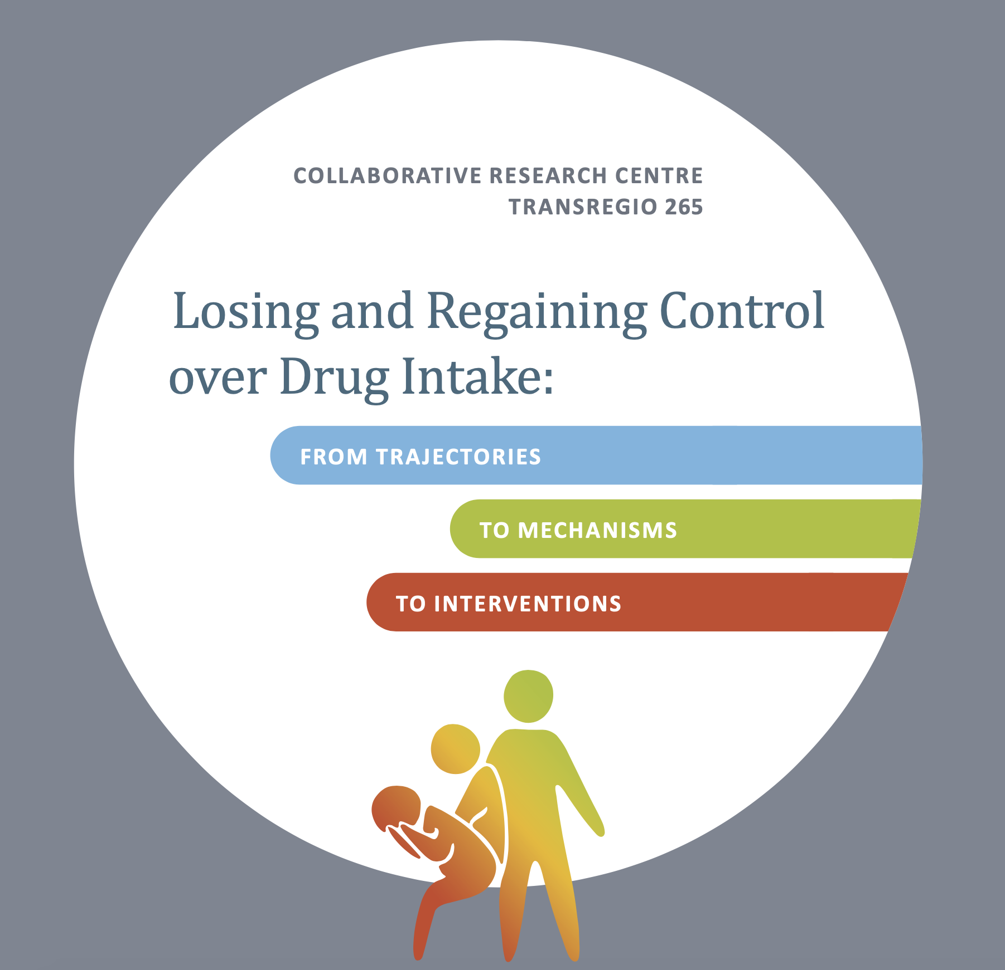
German
Research Foundation
Notes:
Part of larger project funded by the German Research Foundation
Involving three sites
Technical University Dresden
Central institute of mental health mannheim
Charite Berlin (current speaker Prof Heinz)
Focus is on losing and regaining control …

Slide 4
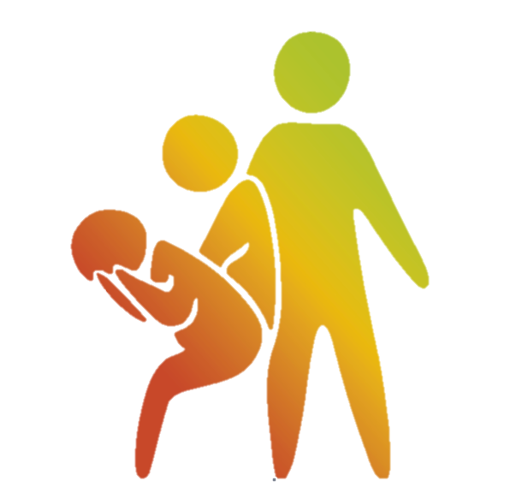
How do people lose control?
19% of people suffering from addiction regain behavioral control over drug intake.
How do they regain control?
Of all drugs, alcohol and tobacco have strongest negative impact on health.
Heinz et al., 2019, Addict. Biol.

Slide 5
Answer from participant via email:
“Antwort 1:
Private, persönliche und viele andere Probleme, aus welchen Bereichen auch immer, können Gründe dafür sein.
Man munkelt sogar, dass auch fröhliche Zusammenkünfte jeglicher Art dafür verantwortlich sein sollen. Manche Menschen trinken sogar einfach nur zum Spaß und aus Langeweile, stellt euch vor!
Antwort 2:
Alkohol macht abhängig, süchtig und krank. Dabei macht bekanntlich die Dosis das Gift.
Warum? In Verbindung mit Antwort 1 sollte das älteste Rätsel der Menschheitsgeschichte nun gelöst sein.
Und das ganz ohne tam-tam, exorbitante Kosten oder irgendwelche Gremien, die sich monatelang über derartigen Quatsch erst noch beraten und Studien erstellen müssen. Es kann so einfach sein, wenn man nur will!”
How do people lose control?
19% of people suffering from addiction regain behavioral control over drug intake.
How do they regain control?
Of all drugs, alcohol and tobacco have strongest negative impact on health.
Heinz et al., 2019, Addict. Biol.

Slide 6
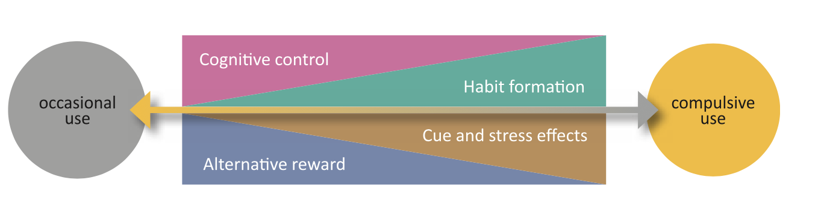
Occasional use
Excessive use
How do people lose control?
19% of people suffering from addiction regain behavioral control over drug intake.
How do they regain control?
Of all drugs, alcohol and tobacco have strongest negative impact on health.
Heinz et al., 2019, Addict. Biol.
Notes:
Control plays an important role in this project
Characterize addiction as gradual shift
from initially occasional controlled use, to excessive uncontrolled use
core mechanisms…

Slide 7
Occasional use
Excessive use
How do people lose control?
19% of people suffering from addiction regain behavioral control over drug intake.
How do they regain control?
Of all drugs, alcohol and tobacco have strongest negative impact on health.
Heinz et al., 2019, Addict. Biol.
Notes:
Hedonic, Goal-directed, flexile - >habitual, automatic, compulsive

Slide 8
Occasional use
Excessive use
How do people lose control?
19% of people suffering from addiction regain behavioral control over drug intake.
How do they regain control?
Of all drugs, alcohol and tobacco have strongest negative impact on health.
Heinz et al., 2019, Addict. Biol.
Notes:
Today I’ll focus on the challenges of relating changes in cognitive control to changes in real-life drinking behavior.

Slide 9
Participants
Occasional use
Excessive use
Mild to moderate Alcohol Use Disorder (AUD)
900 participants (300 in initial dataset)
Notes:
“We include participants that are diagnosed with AUD but only mild to moderate, so these are people who could still improve, but could also deterioate.”

Slide 10
Measuring change
Occasional use
Occasional use
Excessive use
Excessive use
Time (12 month)
Mild to moderate Alcohol Use Disorder (AUD)
900 participants (300 in initial dataset)
Notes:
Cognitive tasks rely on desktop computers and are long and boring
"interfere with their daily routines”

Slide 11

Measuring change
Occasional use
Excessive use
Time (12 month)
Daily alcohol
consumption
Mild to moderate Alcohol Use Disorder (AUD)
900 participants (300 in initial dataset)
Notes:
Today I’ll focus on the challenges of relating changes in cognitive control to changes in real-life drinking behavior.
“today I'm going to focus on the challenges of studying changes in cognitive control and linking it to changes in drinking behavior. The first challenge that we faced in this project is that most people probably never lose control over their driking behavior in their life and consequetly they also don't regain control over their drinking behavior. So to overcome this challenge, we did not test unselected participants but we focused on participanst that ...”
ToDo: Add Zech et al OSF AND ZECH et al in revision and again Heinz et al 2020

Slide 12
Measuring change
Cognitive control
Occasional use
Excessive use
Time (12 month)
Daily alcohol
consumption
Heinz et al., 2020, Addict. Biol.; Zech et al., in revision; Zech et al., OSF.

Slide 13
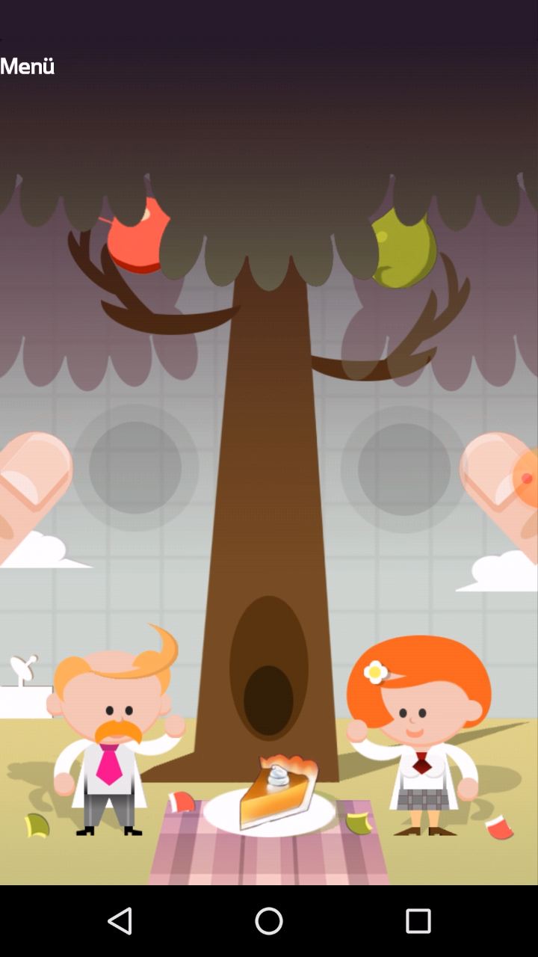
Measuring change in control
Inhibition

Slide 14
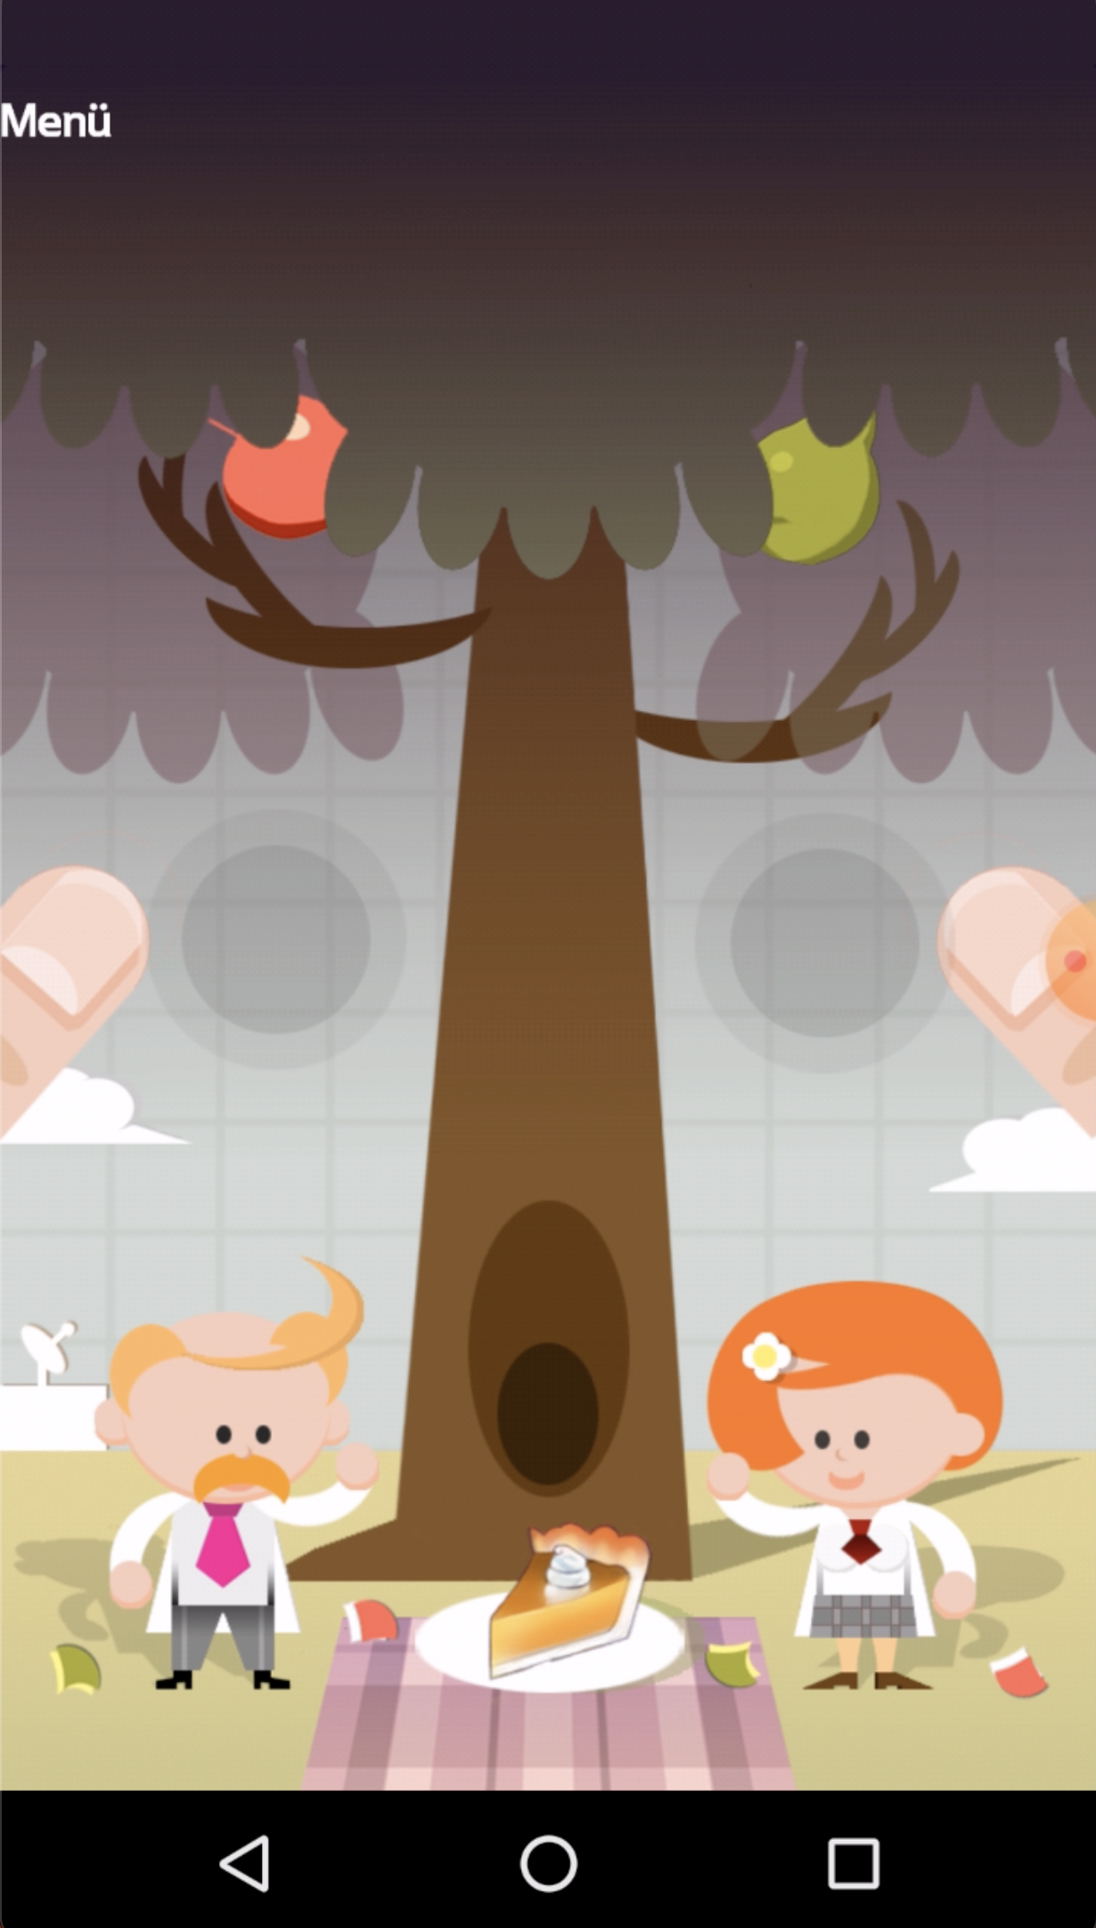
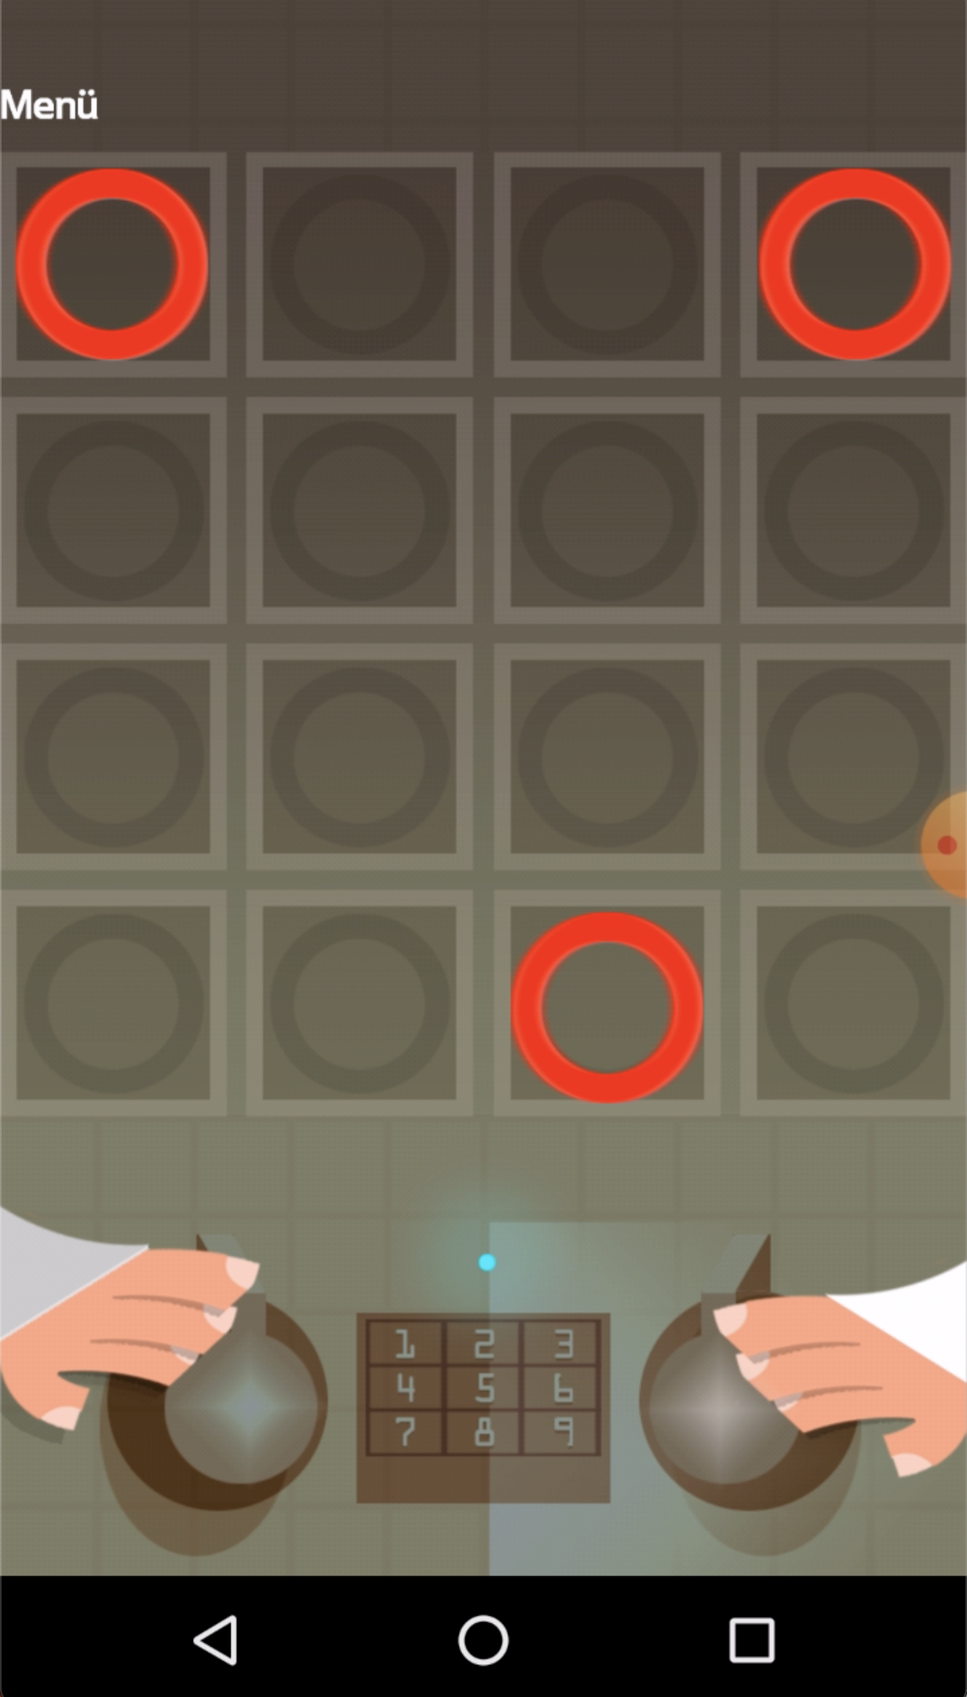
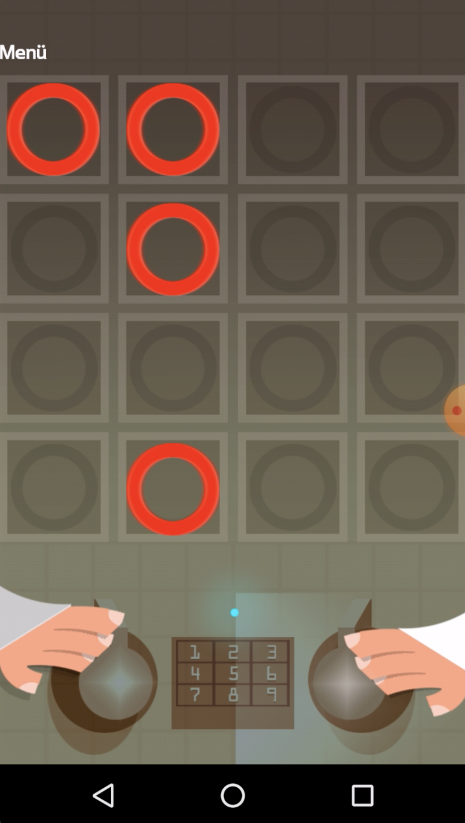
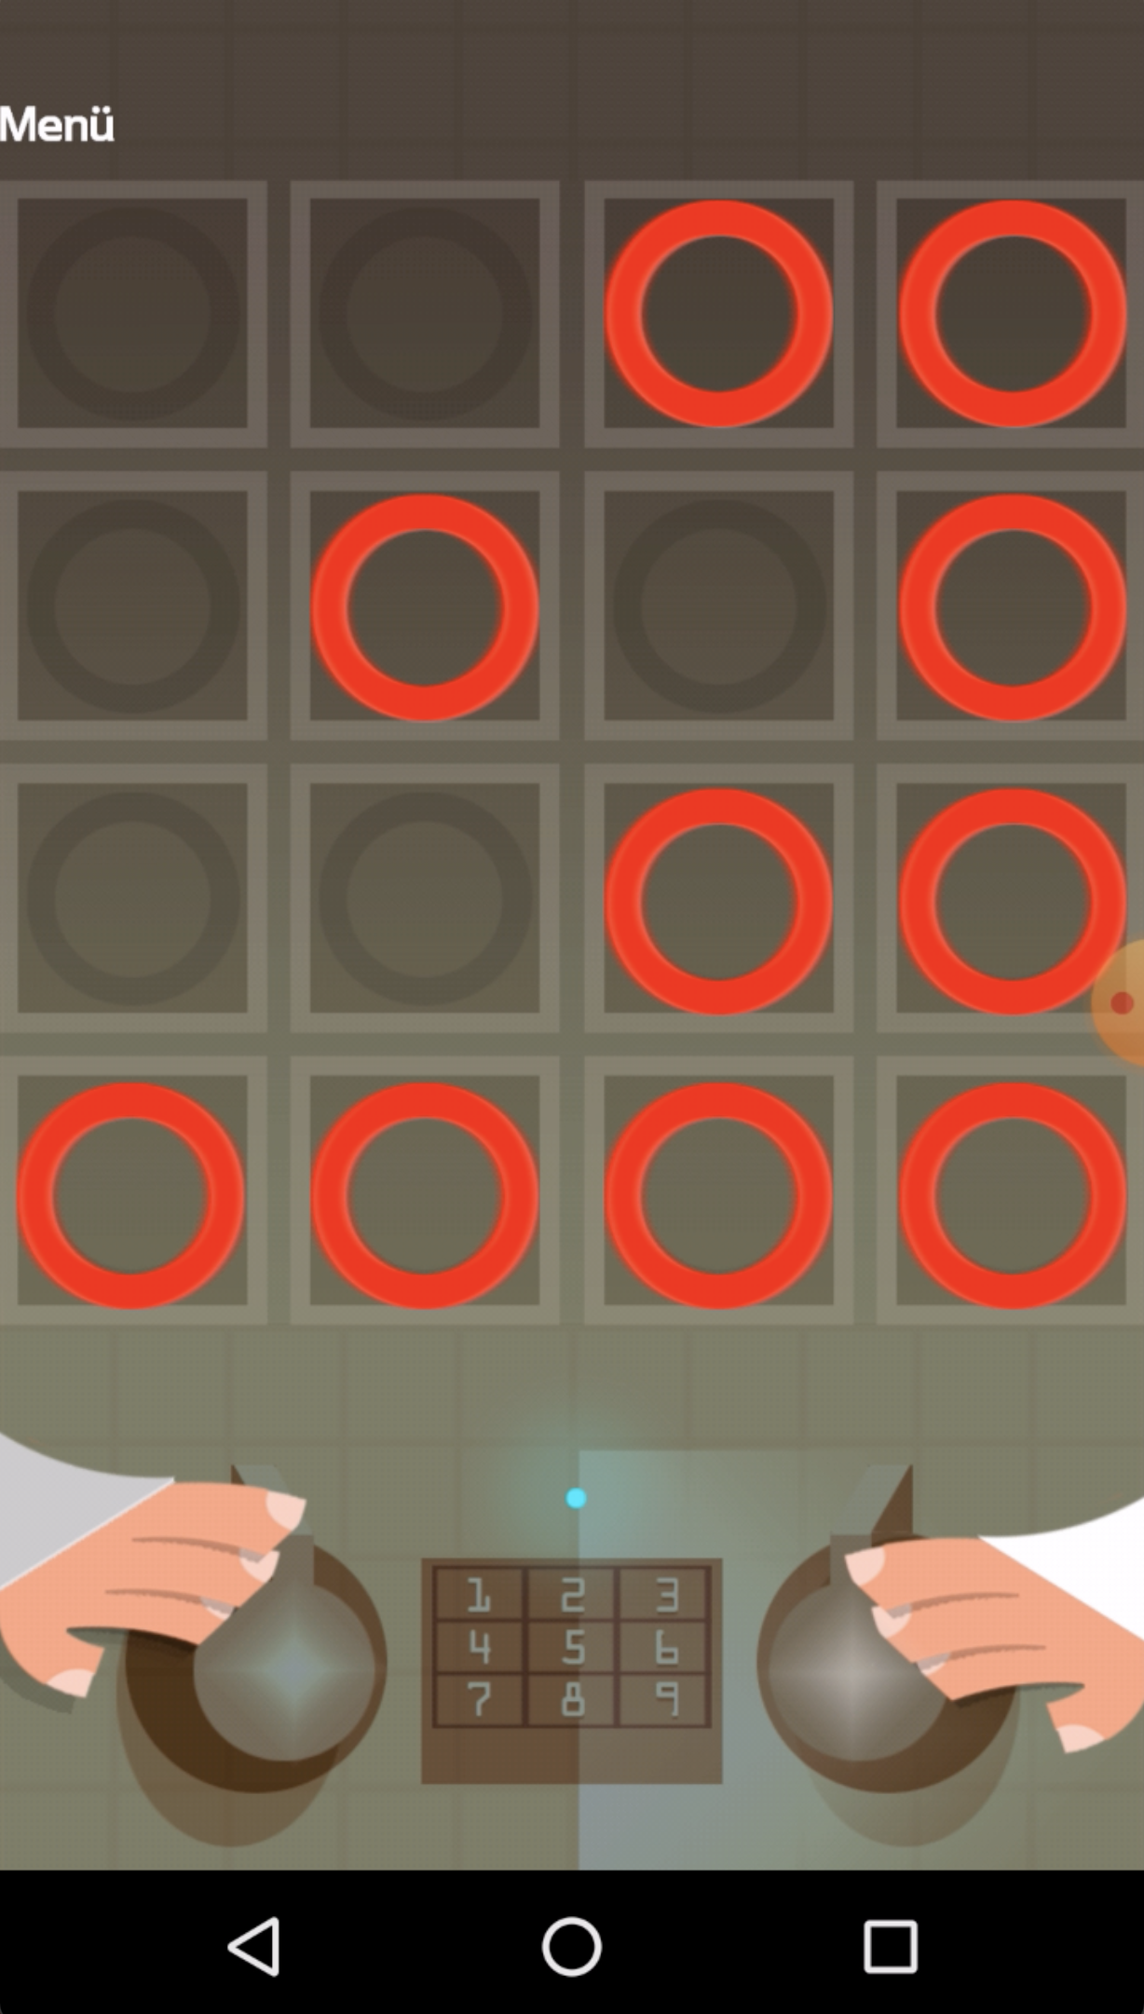
Measuring change in control
Inhibition
Working Memory

Slide 15
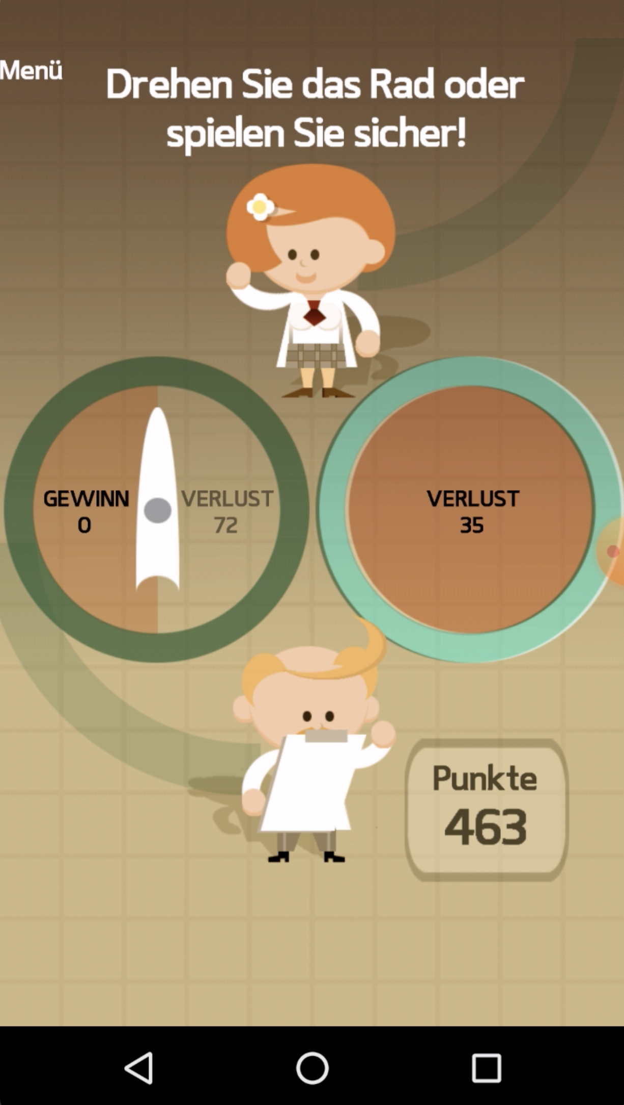
Measuring change in control
Inhibition
Working memory
Risk Taking

Slide 16
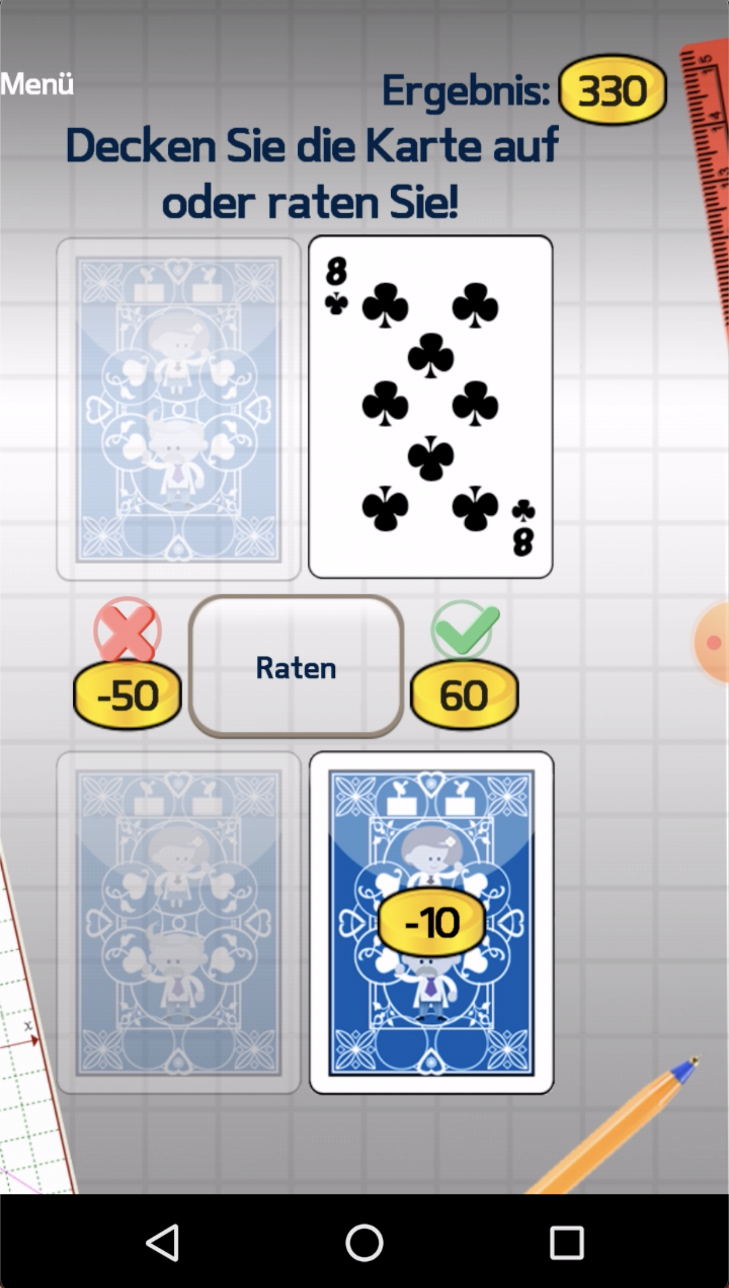
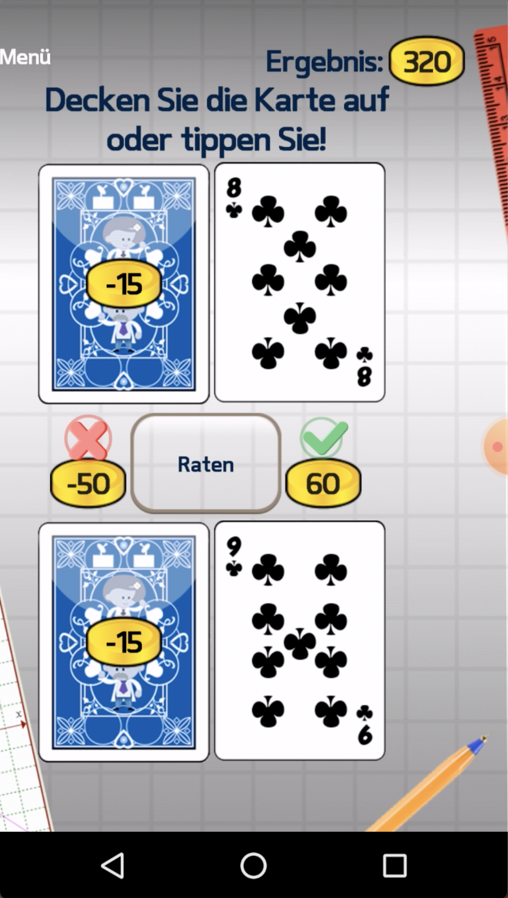
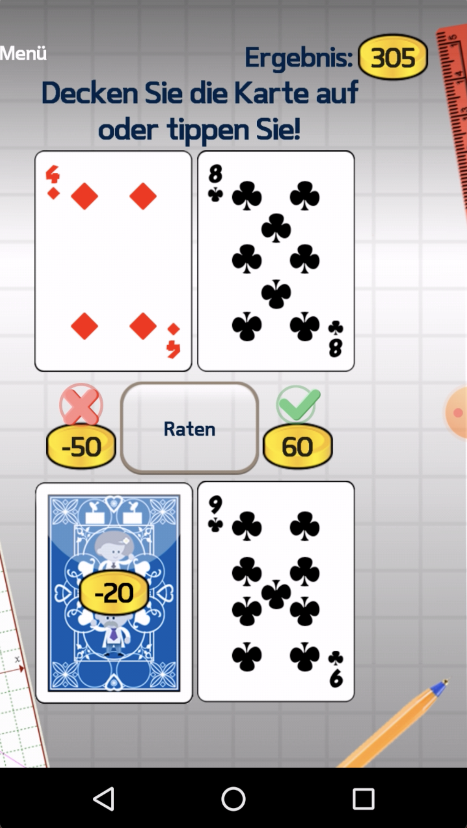
Measuring change in control
Inhibition
Working memory
Risk Taking
Information Sampling
Notes:
Practice more keep it short
keep in mind that thsi task is difficult to nuderstand so better keep it sholt and a bit vague.
"where they can buy more information to become more certain or make a less risky decision".

Slide 17
Measuring change in control
Inhibition
Working memory
Risk Taking
Information Sampling
Notes:
- Fun tasks that run on the smartphone and are also short, however, the shortness of the tasks also comes with a certain challenge:

Slide 18
Reliability
Inhibition
Working memory
Risk Taking
Information Sampling
Notes:
- Fun tasks that run on the smartphone and are also short, however, the shortness of the tasks also comes with a certain challenge:

Slide 19
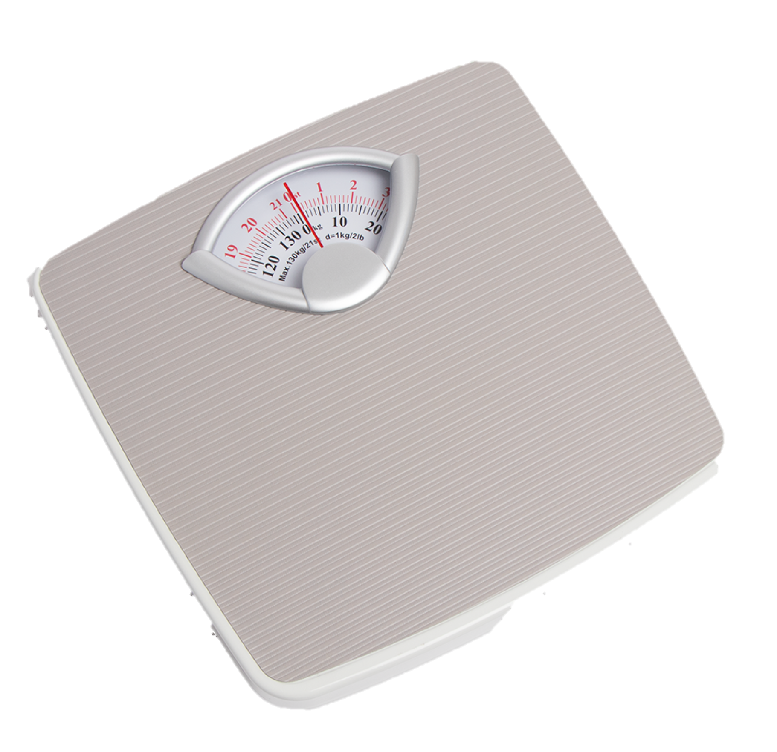
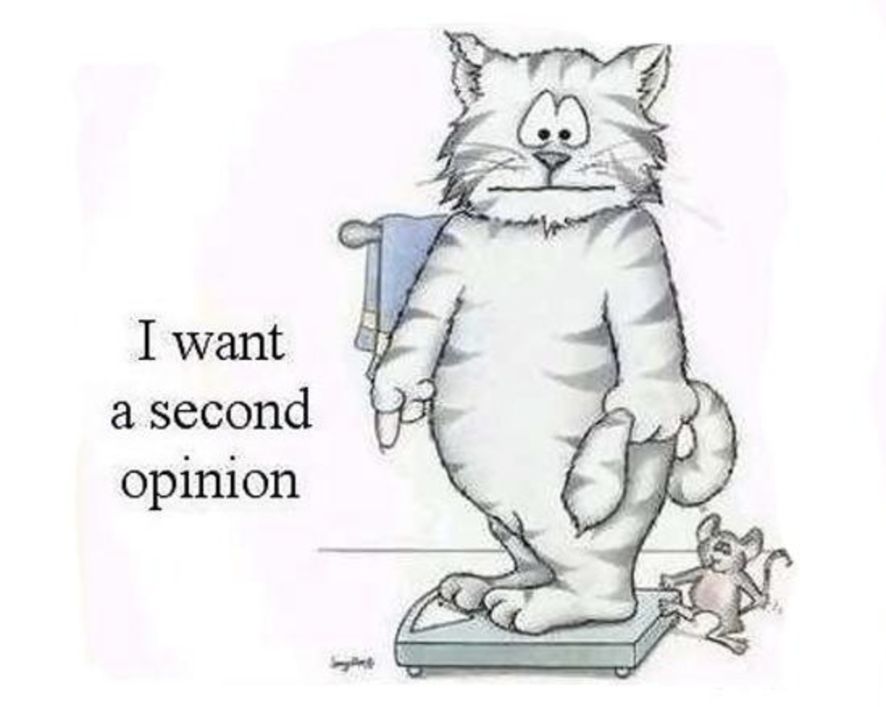
Reliability
…measures how consistent a measurement is.
80 kg
10s
85 kg
Notes:
Many of you may know that reliability refers to “how..’
For example if you think
Step on
Immediately you step again -> 5 k heaver
conclude something wrong
The reason we assume that is that
So we assume that something is wrong
Why is this important for our study and many other studies that correlate measuremenst with each other
Reliability: how consistently does a task measure it construct
[Scale example]
Measurement error (mouse)
Why is this important?
ToDo: Introduce already meaningful variance here and contrast with error variance. (optional: for cog tasks less obvious)

Slide 20
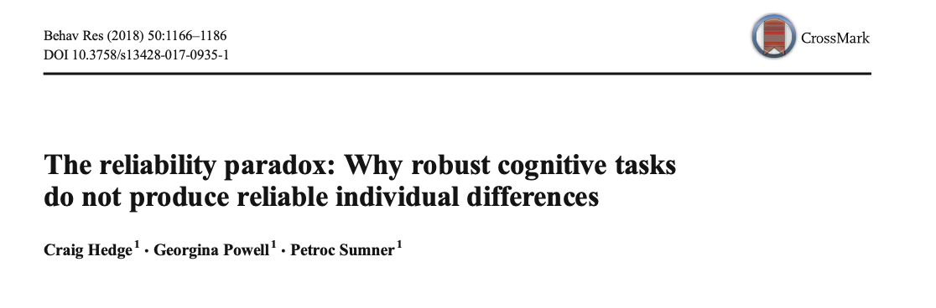

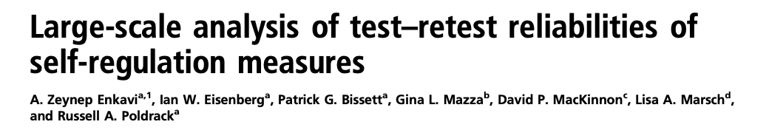
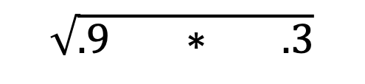
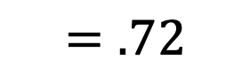
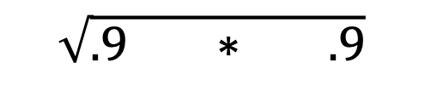

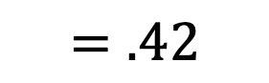
Reliability
$$true correlation∗ \sqrt{reliability_{x}∗reliability_{y}}=observed correlation$$
$$\sqrt{.9 ∗ .3}$$
$$=.42$$
$$.8 ∗$$
$$\sqrt{.9 ∗ .9}$$
$$=.72$$
$$Median reliability of cognitive tasks=.31$$
Notes:
The reason is that
…
Now if you consider that these tasks are designed for the laboratory where there’s very little distraction and that these task are also very long
If you also consider that most correlations that we are interested in in psychology…
You might see that we might have a very difficult time in finding.
ToDo: remove all of the tasks; move Reliability to the middle and everything else to middle.
Reliability: how consistently does a task measure it construct
[Scale example]
Measurement error (mouse)
Why is this important?

Slide 21
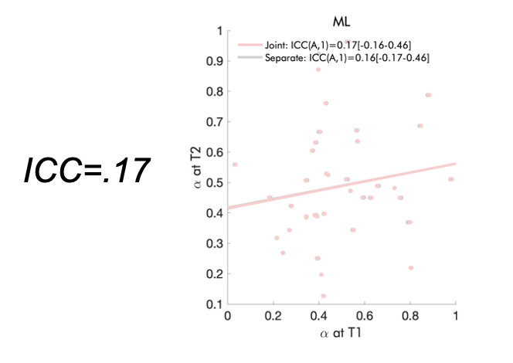
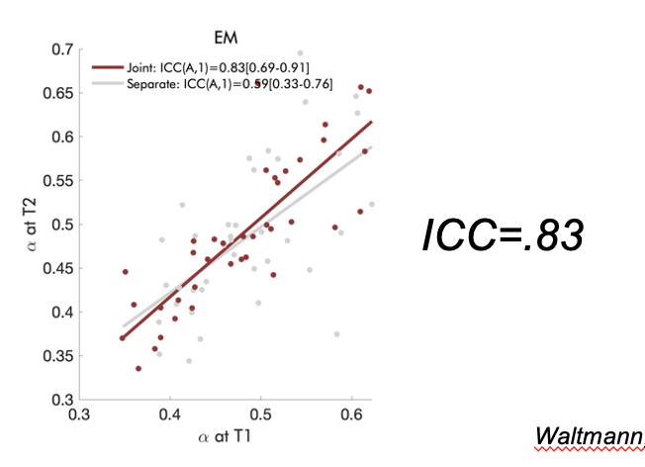
Improving Reliability
Traditional analysis
unchanged
Behavioral Paradigm
Alternative analysis
Modelling each session separately
Modelling all data together
Reliability = .17
Reliability = .83
Waltmann et al., accepted, Behavior Research Methods ; Haines et al, psycharxiv, 2021
Notes:
Recently a method rediscovered by our colleage Maria Waltmann, and the great thing about this method is that we do not actually have to change anything in our tasks, but we only change how we analyze our tasks.
ToDo: Remember that in the aggregation method
ToDo: Don’t give a a value yet (e.g. improvement, better, etc); see if you include aggregation/pooling, if you can make it visually nice
“rediscovered” was good
“And the work by my colleague actuall inidicates” -> Show Maria’s paper after introducing difference but before showing results
Add additional paper (sese old pres)

Slide 22
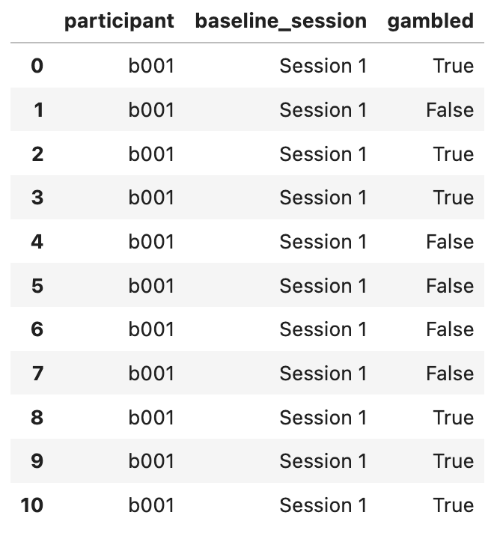
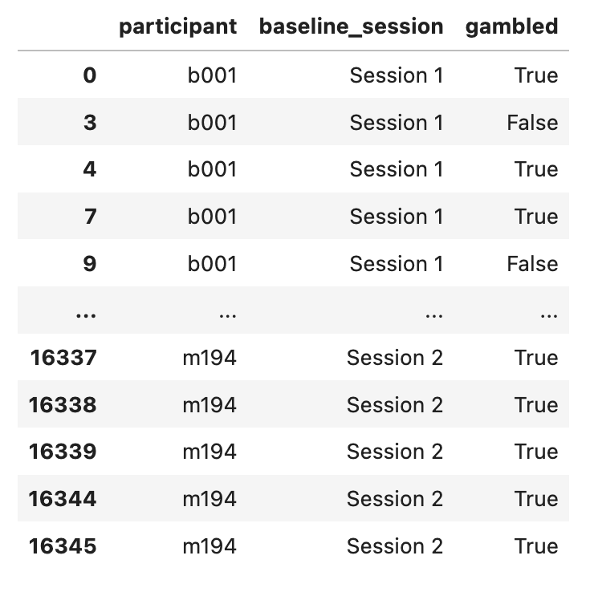
Improving Reliability
Traditional analysis
Alternative analysis
Modelling each session separately
Modelling all data together
Prediction:
51.19%
Aggregation:
54.44%
Notes:
So in this example, we see the data from one participant …
10 trials
Participnats gambled a few times and did not
Our outcome is how often the participant gambled
The improved method instead of …
why could this be desireable, lets go back to our scale example one more time:
ToDo Traditional method/aggregation; again remember not to use improved (better traditional vs alternative/novel)
To keep analogy to scale perhaps better regulate down other value.

Slide 23
Improving Reliability
last 100:
80-81 kg
current:
85 kg
Regularized:
82 kg
Notes:
Back to the scare example.
If you measured weight for last 100 days and it’s always between 80 and 81
Now it’s 85
Old method would have used 85
However, probably involves measurement error and regularized score closer to truth
Does this work in our study?

Slide 24
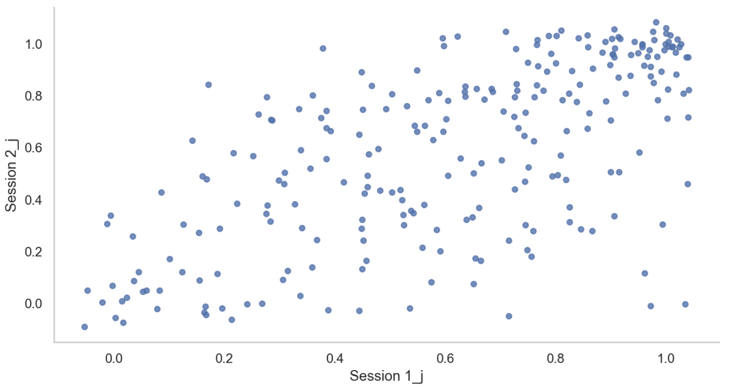
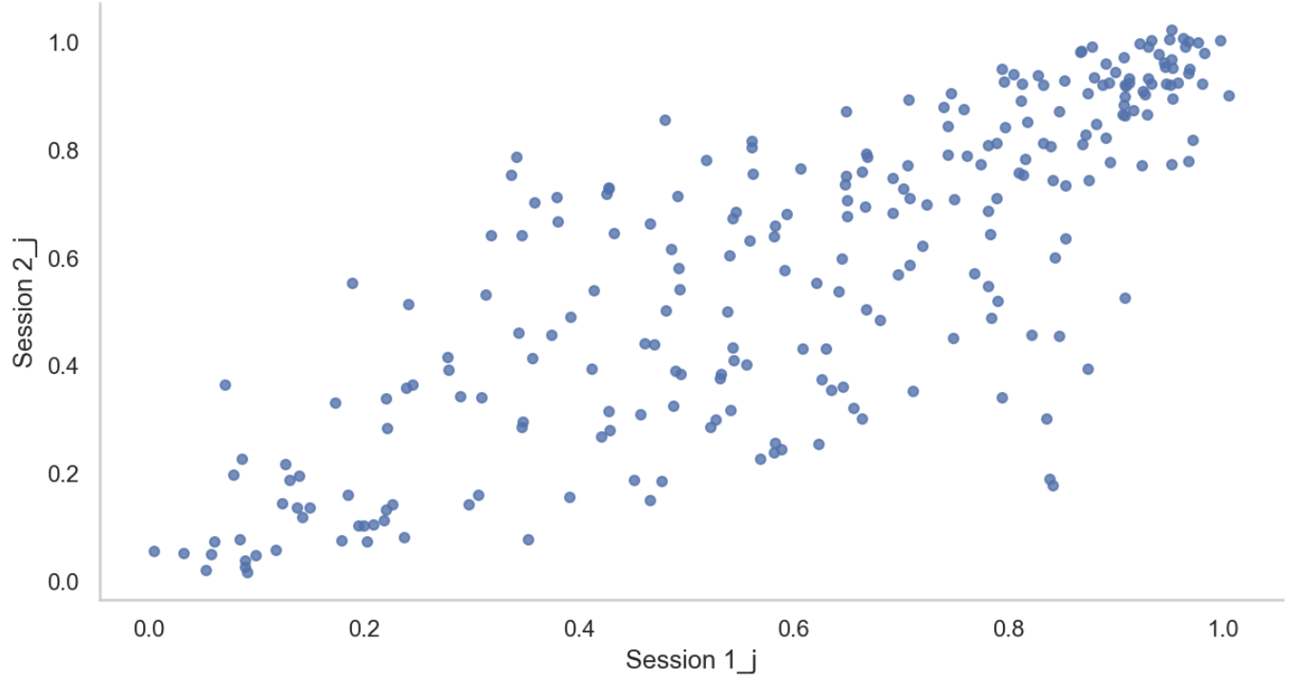
Improving Reliability
Each session modelled separately
All data modelled together
r = .62
r = .83
N = 300
Risk taking
Notes:
ToDo: Skalierung nicht identisch
It does, so if we look at the risk seeking task for example
ToDo: Add sample size (stick to 300).
ToDo: Again not all 4 tasks
ToDo: Add correlation coefficient here and if possible also line.
Yes, as you can see here [explain plot and design]. Initially points are spread apart. With predicted scores closer together. This is closely related to reliability…

Slide 25
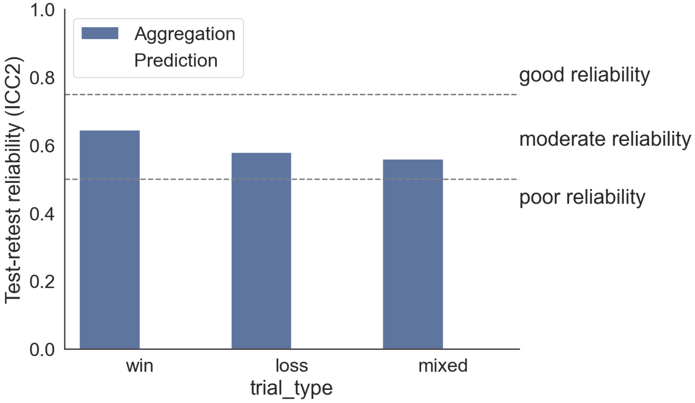
Improving Reliability
Percent gambles
Risk taking
Notes:
ToDo: Add to y-axis task name (on top of test-retest reliability). add task names

Slide 26
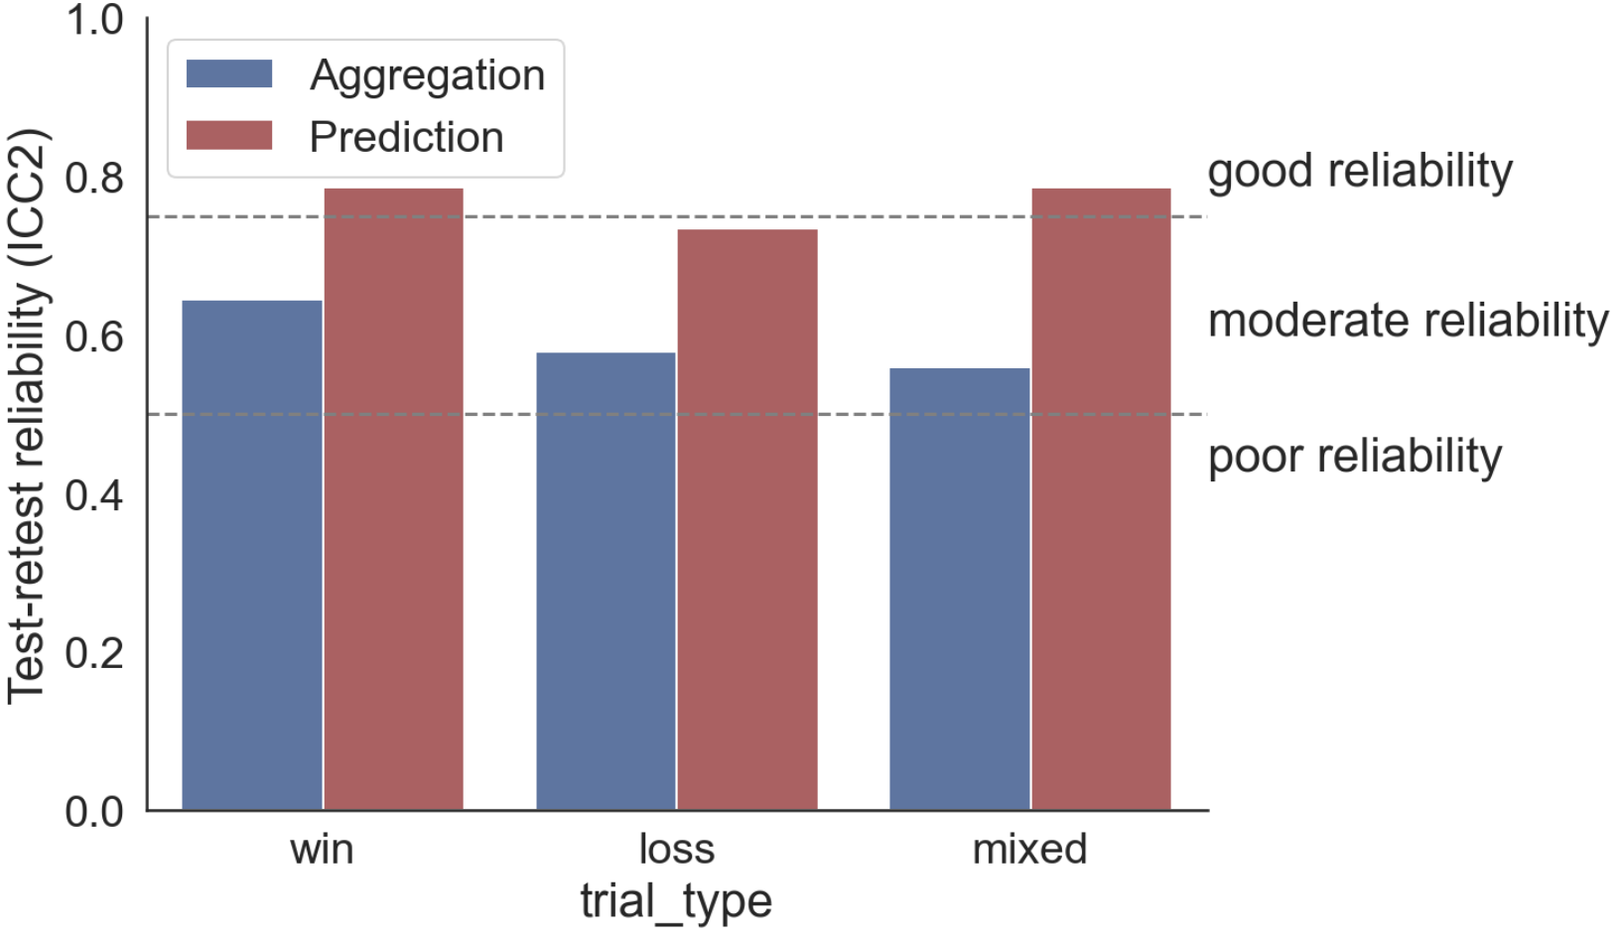
Does reliability improve?
Risk taking
Notes:
ToDo : change prediction
Indeed reliability improves for all conditions.

Slide 27
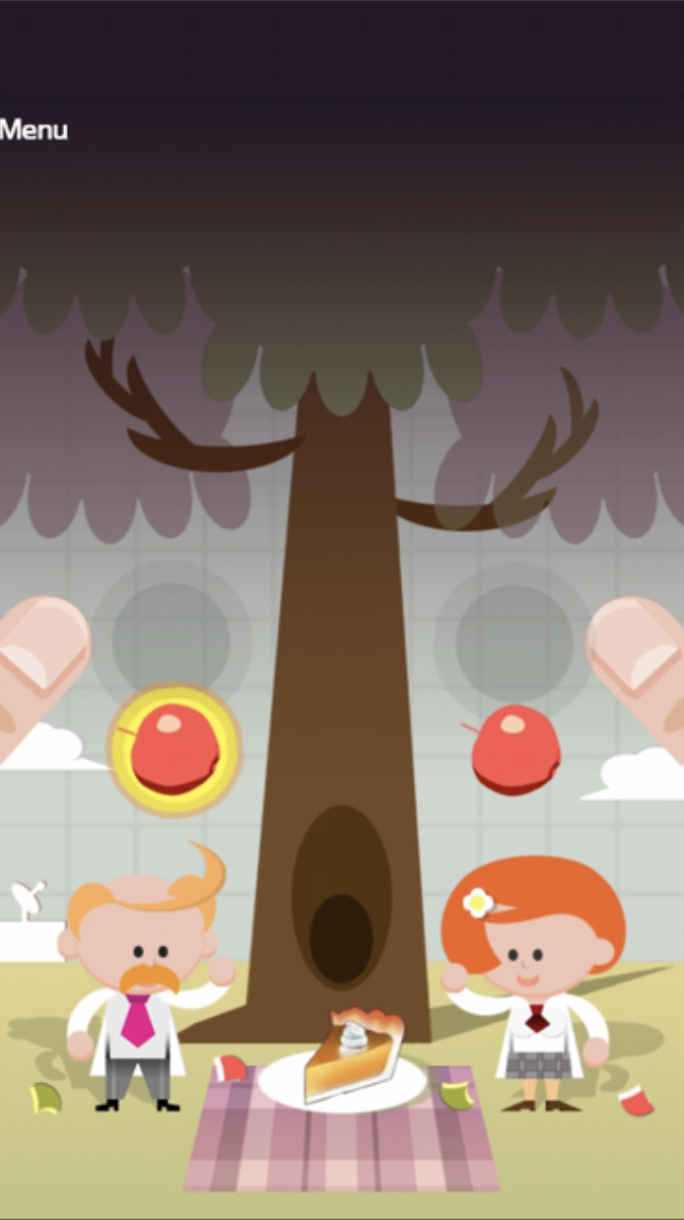
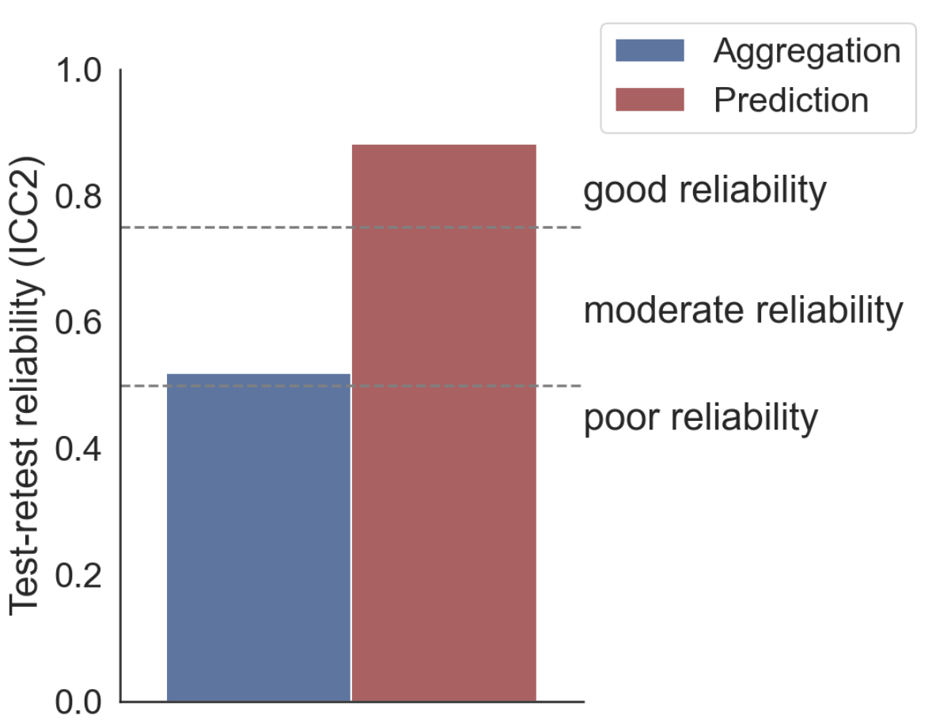
Does reliability improve?
Inhibition
Notes:
T
Indeed reliability improves for all conditions.

Slide 28
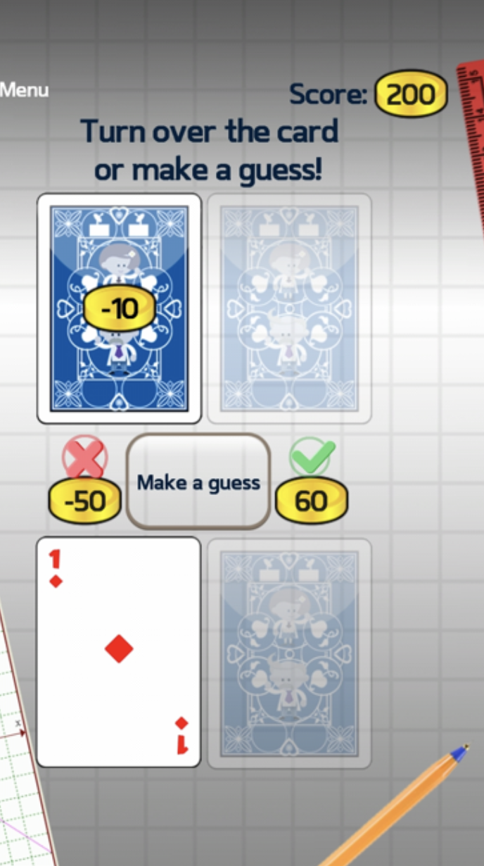
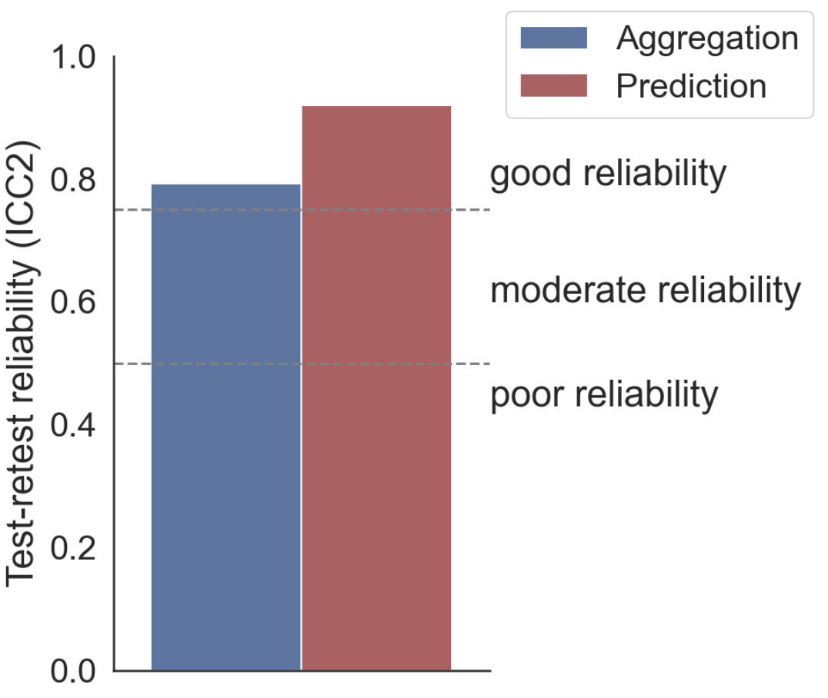
Does reliability improve?
Information Sampling
Notes:
T
Indeed reliability improves for all conditions.

Slide 29
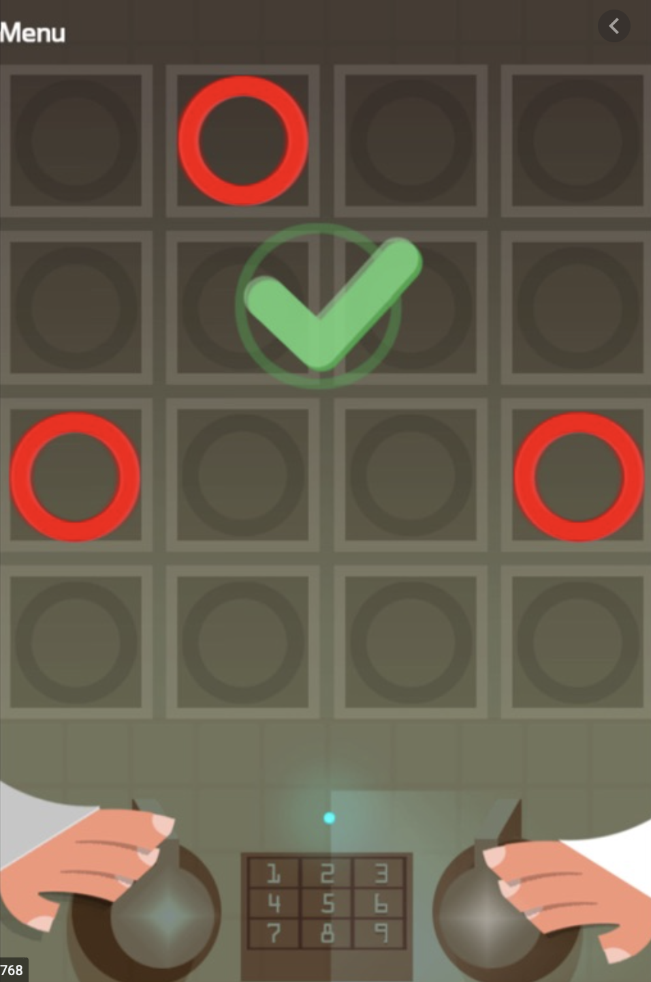
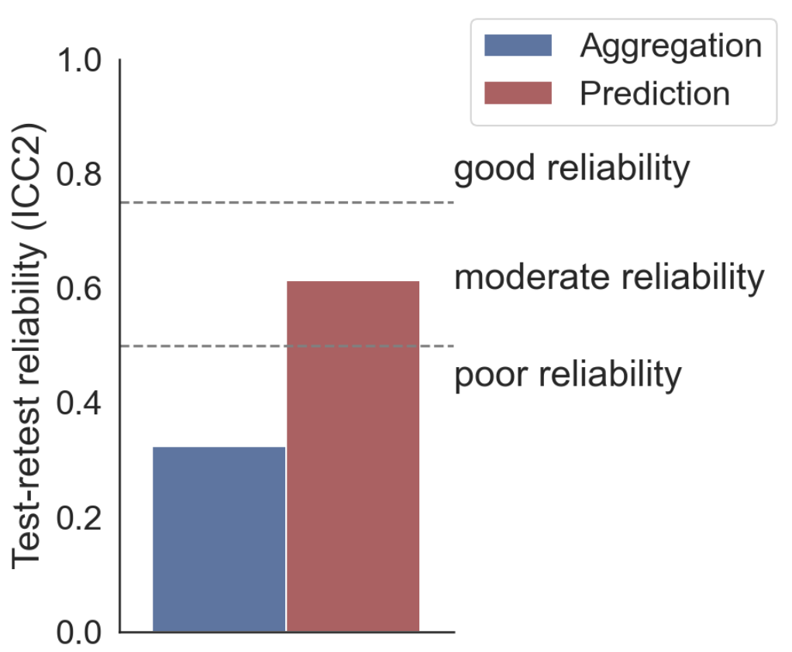
Does reliability improve?
Working memory
Notes:
ToDo: Perhaps add median task reliability line to plot

Slide 30
A: Working memory task
B: Stop signal task
C: Risk taking task
D: Information sampling task

Slide 32
Does reliability improve?
Reliability does improve with alternative method of modelling scores
Is this improvement driven by reduction of systematic (session) variance or reduction of measurement error?

Slide 33
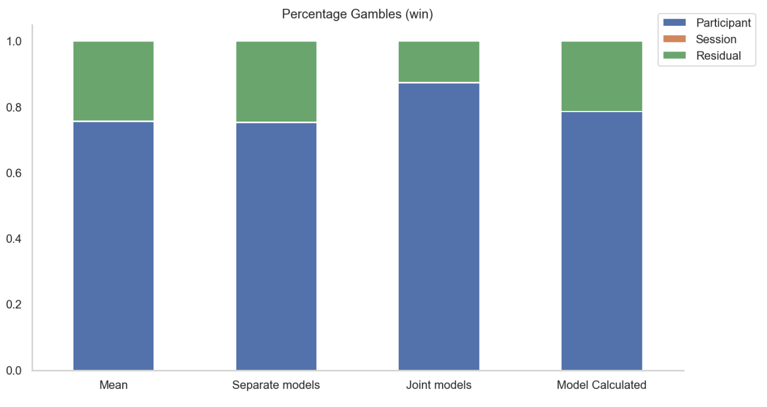
What improves Reliability?
Risk taking (win)
Notes:
ToDo : change prediction
Indeed reliability improves for all conditions.

Slide 34
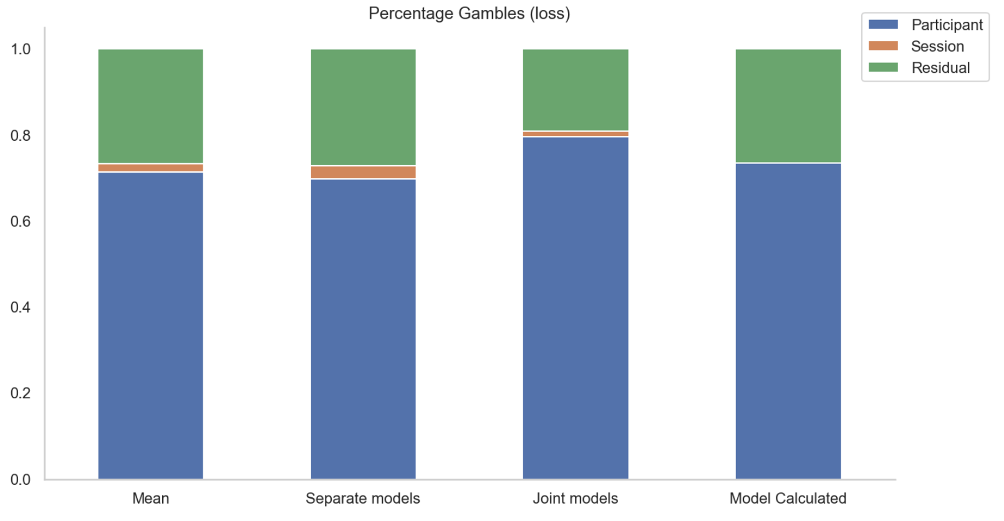
What improves Reliability?
Risk taking (loss)
Notes:
ToDo : change prediction
Indeed reliability improves for all conditions.

Slide 35
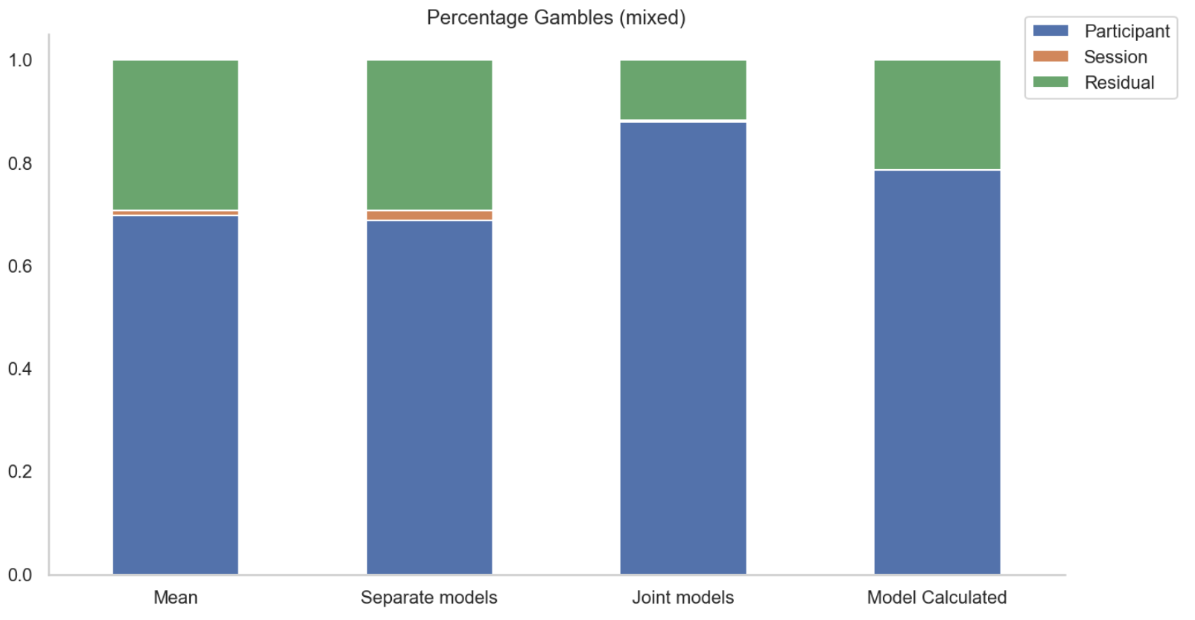
What improves Reliability?
Risk taking (mixed)
Notes:
ToDo : change prediction
Indeed reliability improves for all conditions.

Slide 36
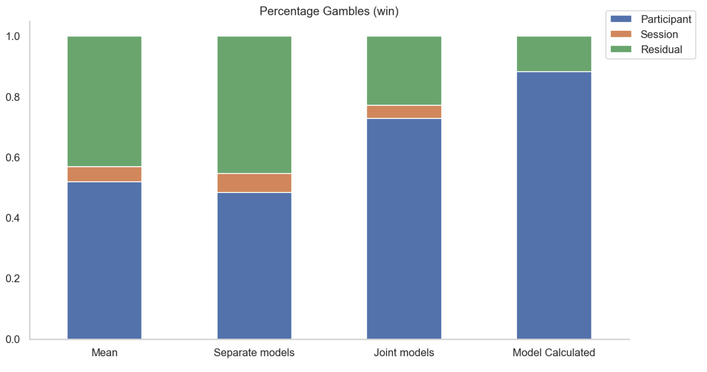
What improves Reliability?
Inhibition
Notes:
ToDo:
Plot this in a way that emphasizes the relationship between session and residual variance
Indeed reliability improves for all conditions.

Slide 37
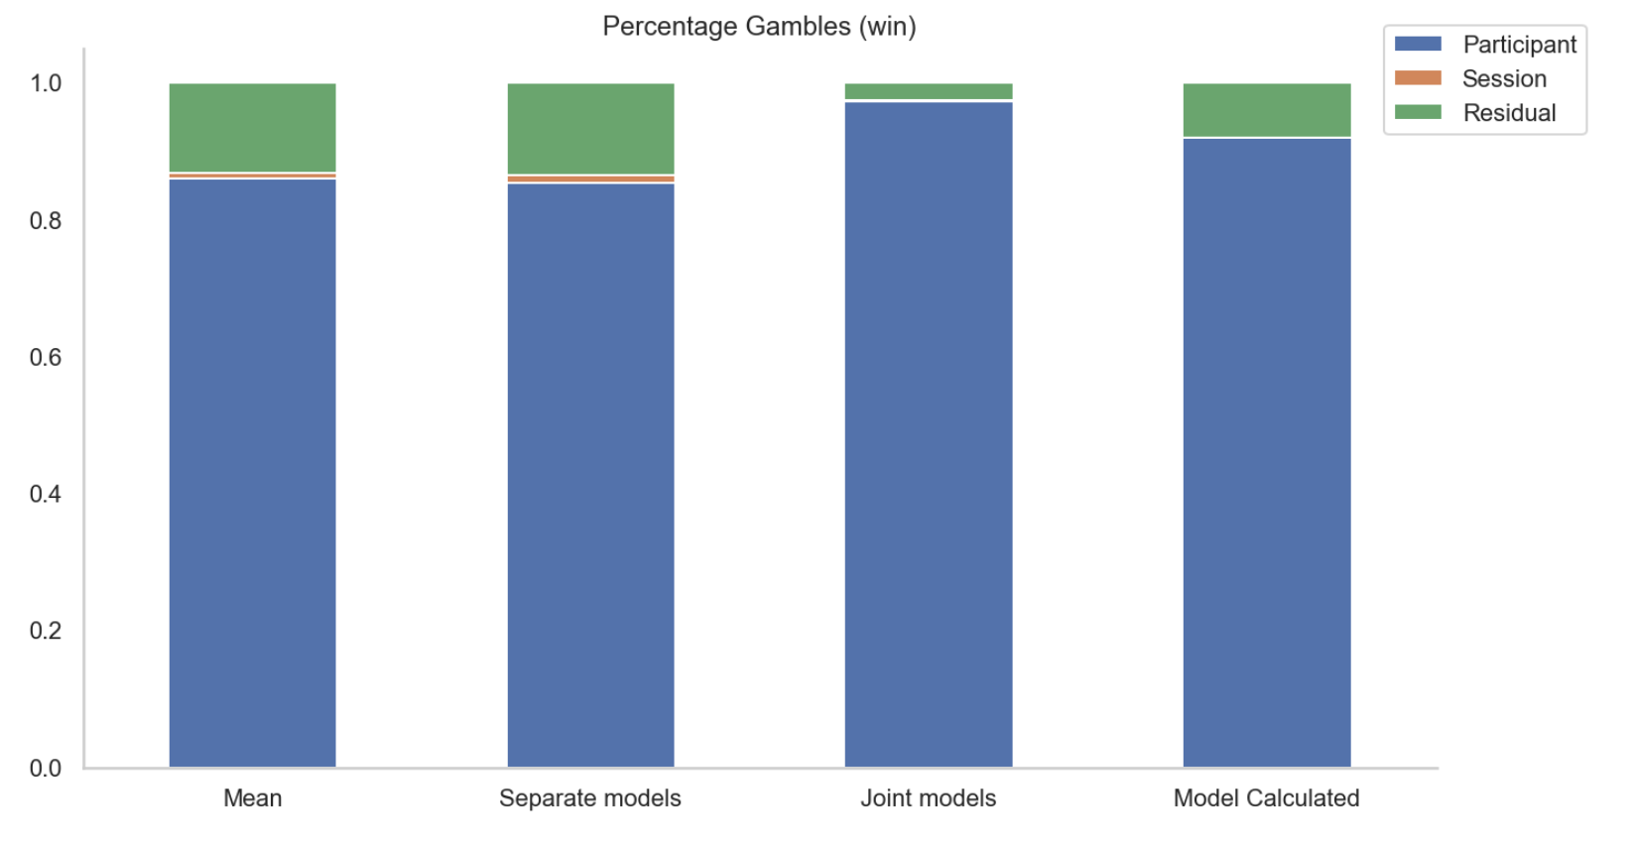
What improves Reliability?
Information Sampling
Notes:
T
Indeed reliability improves for all conditions.

Slide 38
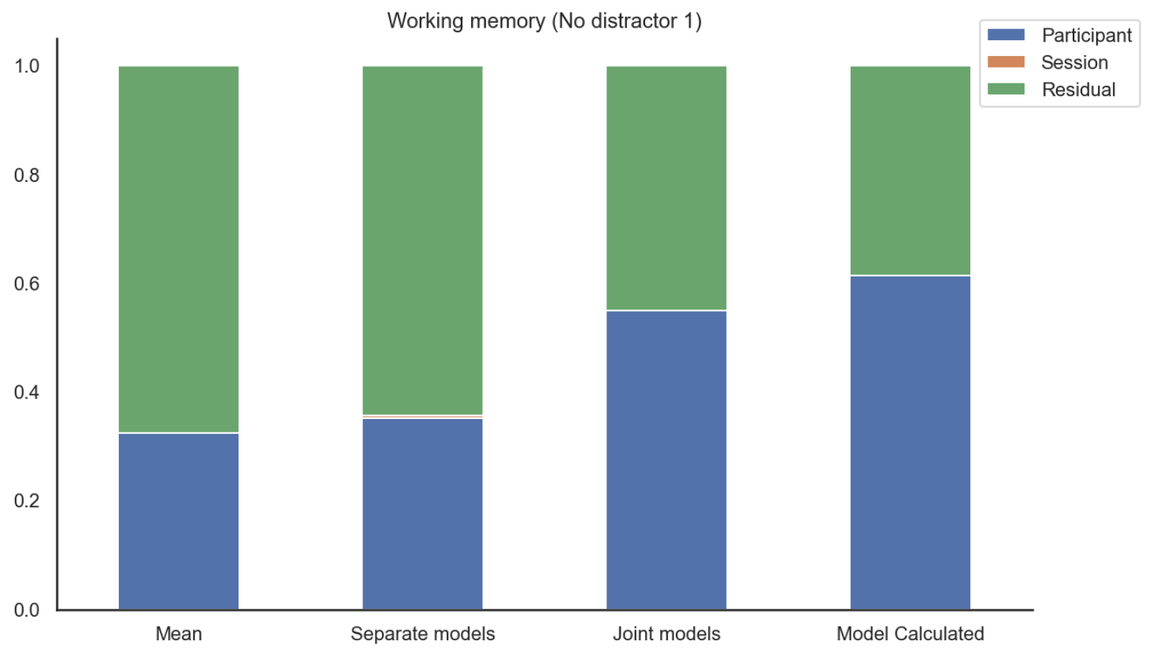
What improves Reliability?
Working memory
No distractor 1

Slide 39
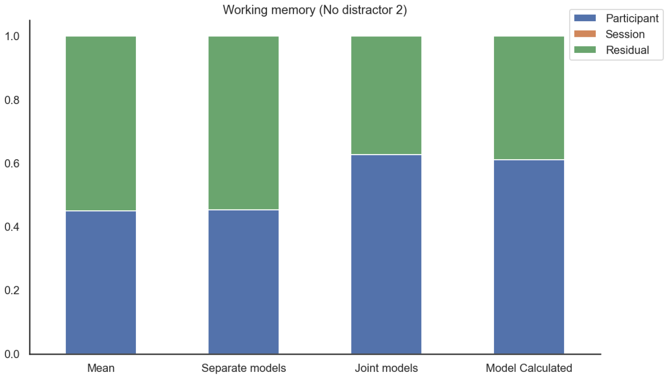
What improves Reliability?
Working memory
No distractor 2

Slide 40
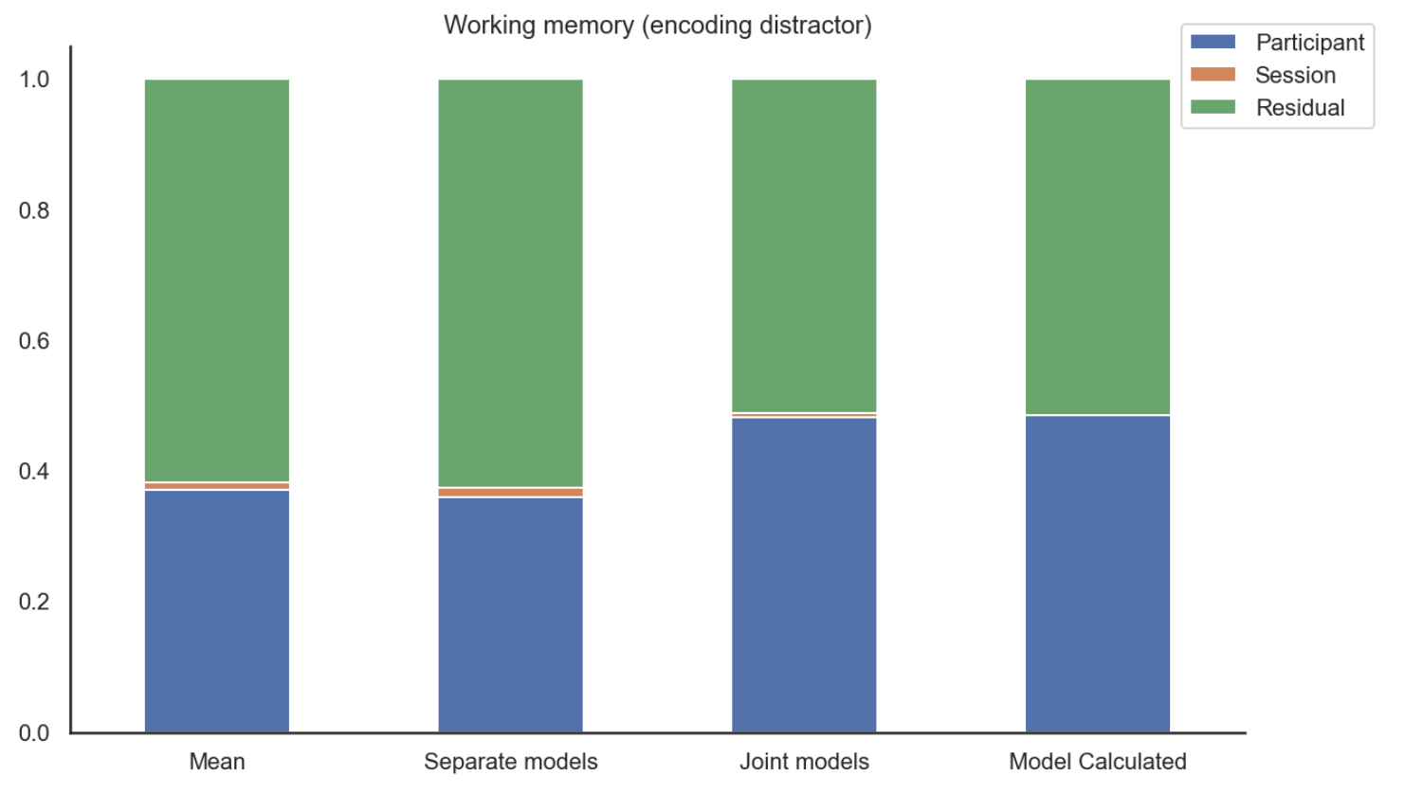
What improves Reliability?
Working memory
Encoding distractor

Slide 41
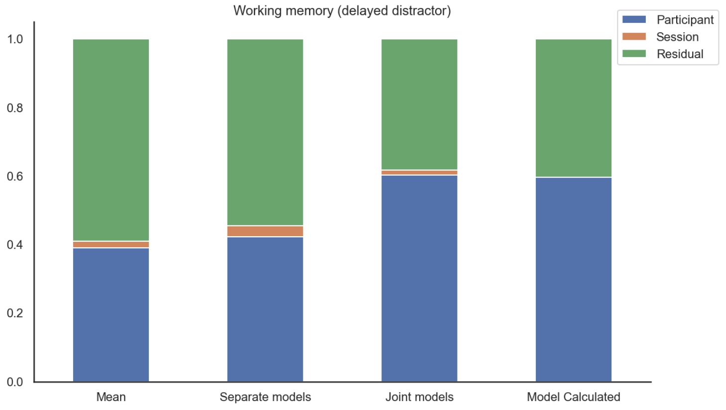
What improves Reliability?
Working memory
Delayed distractor

Slide 42
What improves Reliability?
Reliability is improved by reduction of measurement error.
However, session variance is very low for every task. Does it increase when we increase the retest-period?

Slide 43
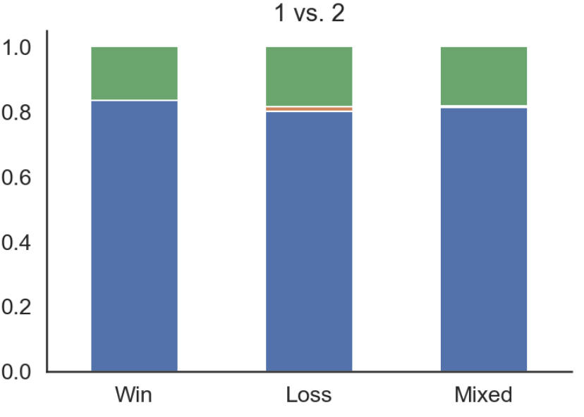
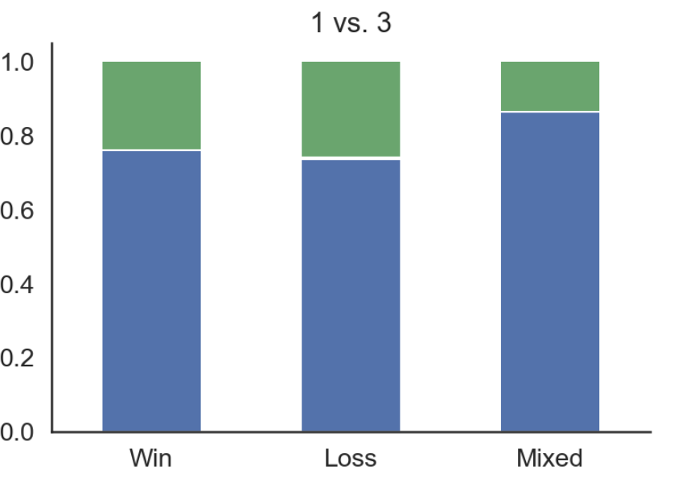
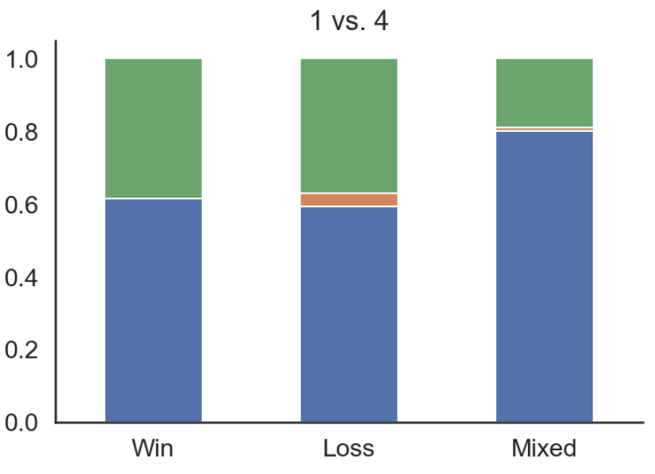
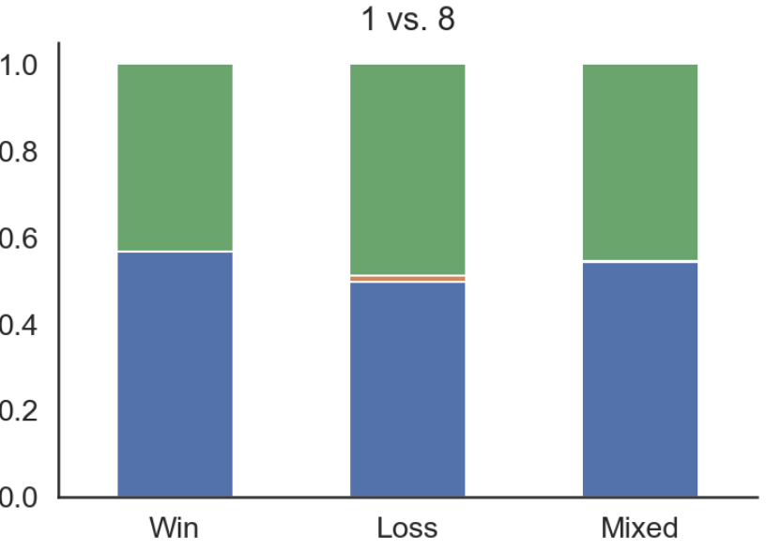
Does time increase session variance?
~ 20 minutes
~ 1 month
~ 2 months
~ 7 months
Risk taking

Slide 44
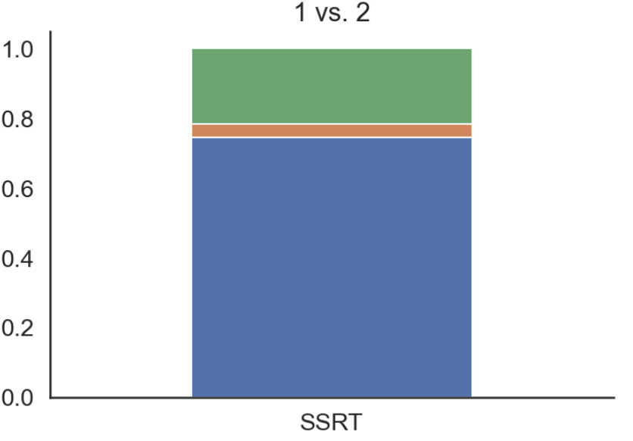
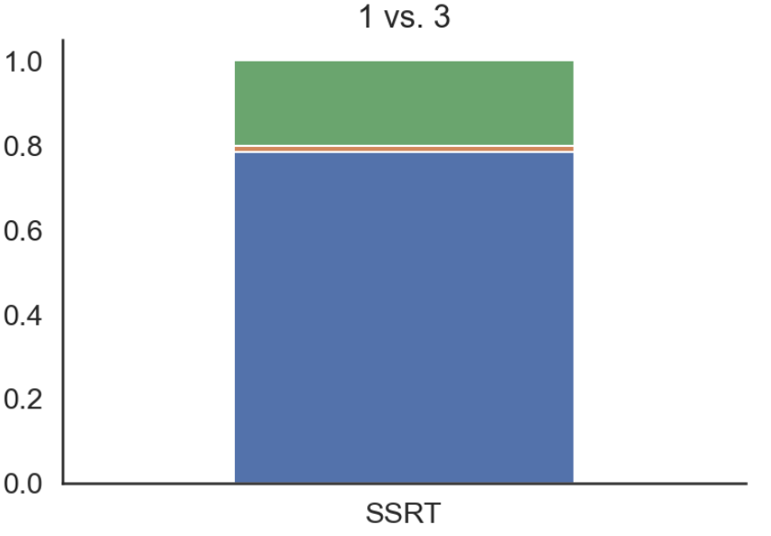
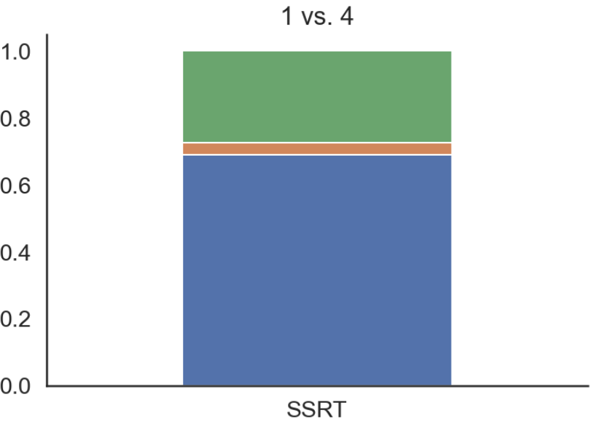

Does time increase session variance?
~ 20 minutes
~ 1 month
~ 2 months
~ 7 months
Inhibition

Slide 45




Does time increase session variance?
~ 20 minutes
~ 1 month
~ 2 months
~ 7 months
Information sampling

Slide 46




Does time increase session variance?
~ 20 minutes
~ 1 month
~ 2 months
~ 7 months
Working memory

Slide 47
Does time increase session variance?
Time does not seem to increase session variance.

Slide 48

Relationship between
tasks and drinking
modeled jointly
SSRTs correlate with WM
WM and SSRT correlate with median EMA drinking (Sperman)
Notes:
ToDo:
Add average drinking per drinking day
Correlation between different months of EMA drinking
Add drinking days (both retrospective and prospective)
How exactly is the last three months question phrased?

Slide 49

Relationship between
tasks and drinking
modeled seperately
SSRTs correlate with WM
WM and SSRT correlate with median EMA drinking (Sperman)
Notes:
ToDo:
Add average drinking per drinking day
Correlation between different months of EMA drinking
Add drinking days (both retrospective and prospective)
How exactly is the last three months question phrased?

Slide 50

Relationship between
tasks and drinking
SSRTs correlate with WM
WM and SSRT correlate with median EMA drinking (Sperman)

Slide 51

Relationship between
tasks and drinking
SSRTs correlate with WM
WM and SSRT correlate with median EMA drinking (Sperman)

Slide 52

Relationship between
tasks and drinking
SSRTs correlate with WM
WM and SSRT correlate with median EMA drinking (Sperman)

Slide 53

Relationship between
tasks and drinking
SSRTs correlate with WM
WM and SSRT correlate with median EMA drinking (Sperman)

Slide 54
Summary
We can create model-based tasks scores.
We can improve reliability by modelling data together.
Session variance is low.
Some relationships between baseline tasks and drinking.
Notes:
toDo if possible add drinking (but not necessary)
ToDo: Perhaps also say that it’s nice that on the one hand the longitudinal data makes tasks potentially less reliable, but it also makes it possible to collect more data and make tasks more reliable.
[todo: Add a picture for each summary point]

Slide 55

Next steps
Reliability/Baseline manuscript
Longitudinal analyses (+ High-frequency data)
Eldar collaboration
Meeting with Eran tomorrow to look at code (to prepare ethics)
Prepare ethics amendment
Working on technical challenges (e.g. getting data from newest version of portable EEG)
Notes:
toDo if possible add drinking (but not necessary)
ToDo: Perhaps also say that it’s nice that on the one hand the longitudinal data makes tasks potentially less reliable, but it also makes it possible to collect more data and make tasks more reliable.
[todo: Add a picture for each summary point]

Slide 56
What improves Reliability?
Risk taking (win)
Notes:
ToDo : change prediction
Indeed reliability improves for all conditions.

Slide 57
Improving Reliability
Reliability is improved by modelling all data at once.
Is this always a good thing?
last 100:
80-81 kg
current:
85 kg
Regularized:
82 kg
Notes:
We can conclude that reliability is improved when modelling all data at once. But is this always a good thing:
So far in the examples, we assumed that the change in scores was driven by measurement error. But what if the change is not caused by measurement error but by an actual change in the weight (perhaps the cat ate a lot of lasagna the day before).
We can check the impact of different sources of variance in our task…

Slide 58


Improving Reliability
Reliability is improved by modelling all data at once.
Is this always a good thing?
current:
85 kg
Regularized:
82 kg
Notes:
ToDo replace with loss condition, so the session does not completely disappear
Show that session variance does not disappear completely.
And it shows that while there is a lot of measurement error with the aggregation scores, there is significantly less with the predicted scores (session variance is low as expected because tasks are close to each other.)
if somebody asks about the relative change, this is something that we have to look into.

Slide 59
Improving Reliability
Reliability is improved by modelling all data at once.
Is this always a good thing?
In this case yes.
current:
85 kg
Regularized:
82 kg
Notes:
Show that session variance does not disappear completely.
And it shows that while there is a lot of measurement error with the aggregation scores, there is significantly less with the predicted scores (session variance is low as expected because tasks are close to each other.)
if somebody asks about the relative change, this is something that we have to look into.
todo: be abit more carefoul in concluses : this suggests

Slide 60



First look at drinking data
Notes:
I’m now moving to drinking data.
Show the plot from Deeken et al. in prep. -> Which also shows that drinking data is much more challenging
As you can see it’s much more challenging.
Mention sample -> We have x cross-sectional, and so many longitudinally, but unfortunately analysis is still work in progress (I would have like to show you more).
ToDo: Add reference ; “Because I don’t have any…, I will share some other” Add that the weekly pattern interacts with AUD severity (becomes lower with higher AUD severity; from Deeken paper) perhaps also add the AUD plot

Slide 61
Next steps
Test Task Validity
Analyze relationship between drinking and control at baseline
Analyze relationship between drinking and control longitudinally.
Notes:
I’m now moving to drinking data.
Show the plot from Deeken et al. in prep. -> Which also shows that drinking data is much more challenging
As you can see it’s much more challenging.
Mention sample -> We have x cross-sectional, and so many longitudinally, but unfortunately analysis is still work in progress (I would have like to show you more).

Slide 62
Summary
Smartphone-based data collection is a useful tool to study change in drinking.
This requires short (and ideally fun) cognitive tasks.
Short cognitive tasks are generally less reliable, thus decreasing observed correlations.
Reliability can be improved by pooling data.
This improvement is mainly driven by a decrease in measurement error.
Drinking effects are being analyzed and will be available soon.
Notes:
toDo if possible add drinking (but not necessary)
ToDo: Perhaps also say that it’s nice that on the one hand the longitudinal data makes tasks potentially less reliable, but it also makes it possible to collect more data and make tasks more reliable.
[todo: Add a picture for each summary point]

Slide 63





Contributers
Lorenz Deserno and Maria Waltmann
Cognitive Neuroscience in Developmental Psychiatry, University of Würzburg
Michael Smolka
Systems Neuroscience, TU Dresden
Ray Dolan
Max Planck UCL Centre for Computational Psychiatry
and Ageing Research, University College London
Andreas Heinz
Charité, Humdoldt University of Berlin
Heike Tost
Central Institute for Mental Health, Mannheim
Michal Rapp
University of Potsdam
The ReCoDe Consortium
German
Research Foundation
Notes:
Very grateful for all these amazing collaborators -> Mention all the different sites, mention a couple of names.; try to copy Lorenz thank you slide (photos of people not necessary)
Departmeent of Psychiatry Dresden
Michael perhaps add some people who helped recruit
Würzburg
Lorenz Maria
UCL
Ray Dolan
Charite Berlin
Andreas Heinz
ZI Mannheim
Heike Tost
Uni Potstdam
Michael Rapp

Slide 64
Thank you for your attention!

